Slide 1
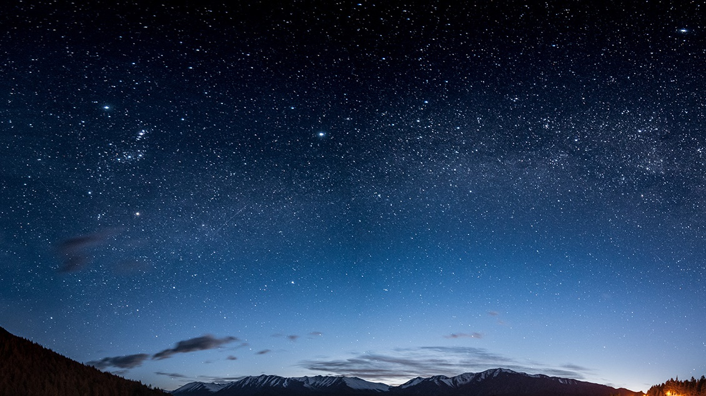
Know iitr
Aries project submission

Slide 2
Table of contents
Problem statement
Development
Challenges
Future Plans

Slide 3
Problem statement
Visitors to IIT Roorkee often struggle to navigate the campus and understand the history and significance of the various buildings. This lack of information can lead to a less-than-optimal experience for visitors, who may miss out on important details or attractions. There is a need for a solution that provides visitors with an easy and engaging way to learn about the campus and its buildings, in order to enhance their experience and appreciation of IIT Roorkee.
"Know IITR" is an app designed to meet this need, by using augmented reality and 3D models to provide visitors with an immersive and informative experience.

Slide 4
Development
The App is Completely Made Using Unity, the 3d Model was made using Blender and the following SDKs were Used:-
i) AR Core :- For Image Tracking and AR Development
ii) Ready Player Me :- For Importing an Custom 3d Model from Ready Player Me
iii) Google Text To Speech :- For Converting Text to Audio on runtime
iv) OVR Lipsync for Unity :- For Syncing the Lips of the 3d Character with the Audio

Slide 5

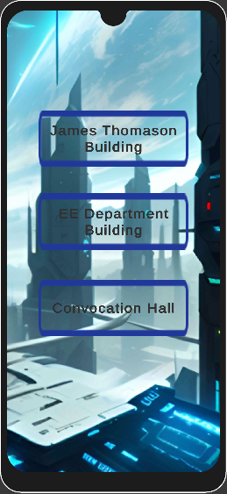
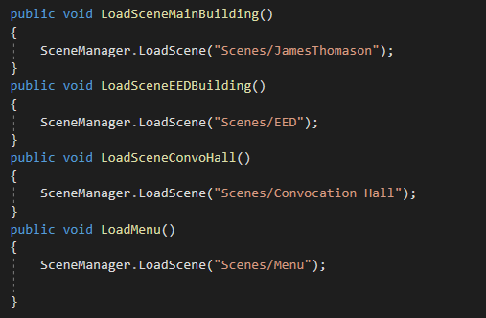

Slide 6
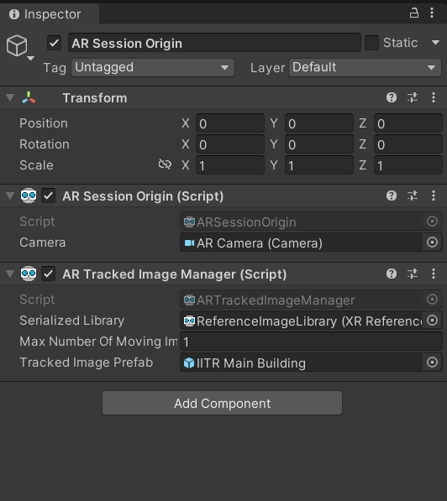
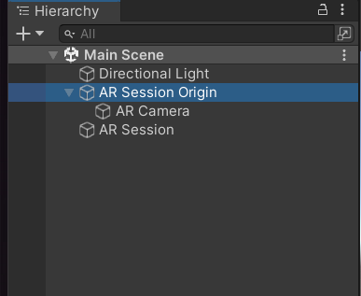
AR core

Slide 7
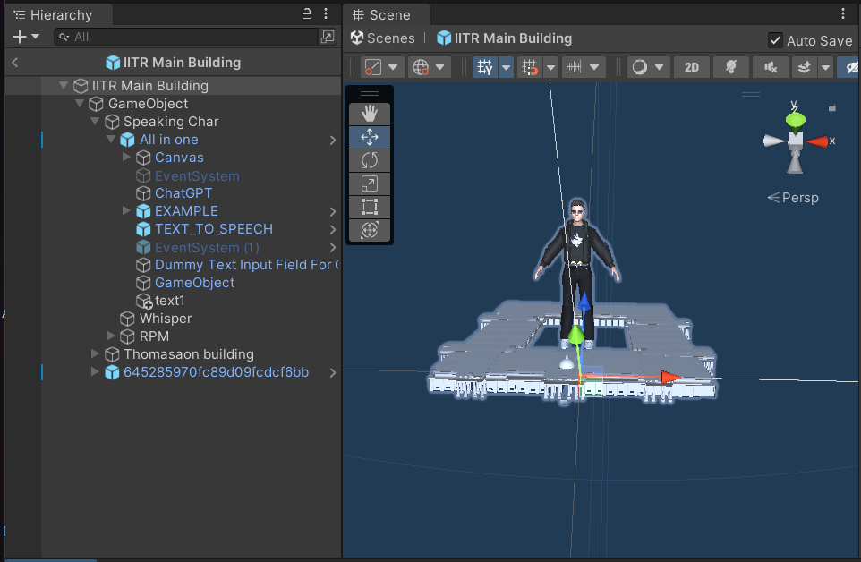
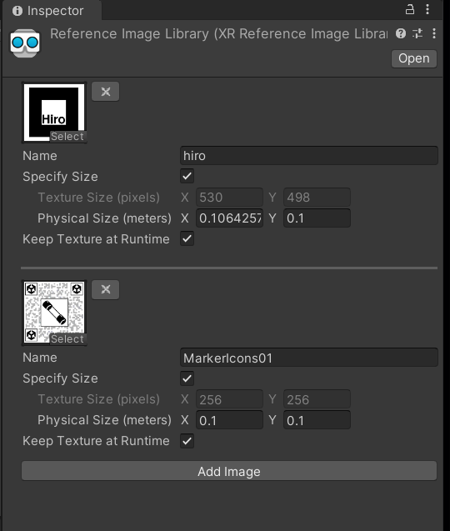

Slide 8
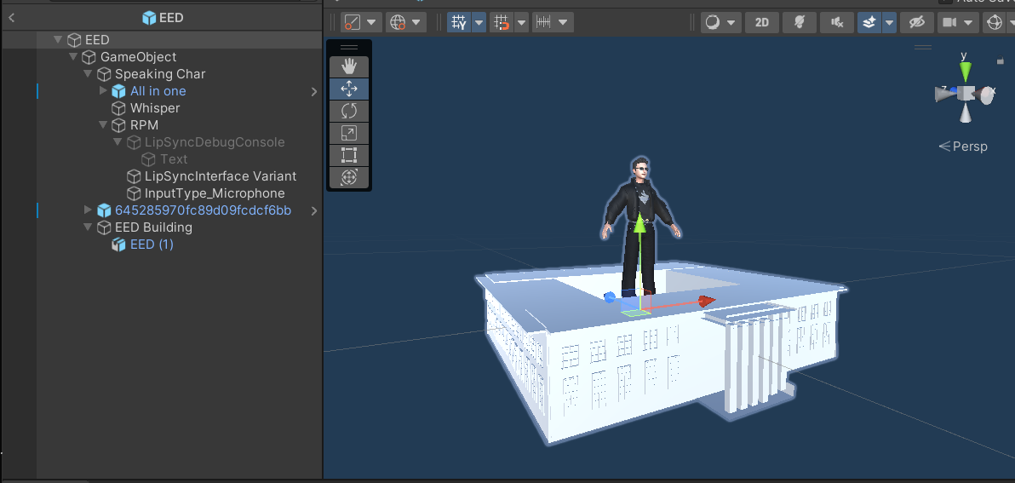

Slide 9
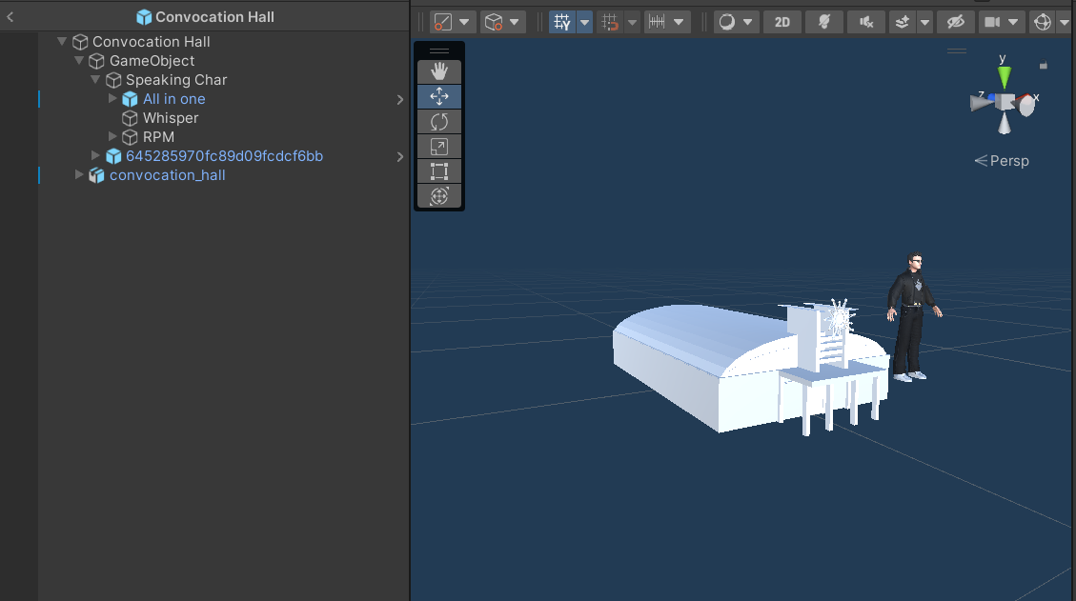

Slide 10
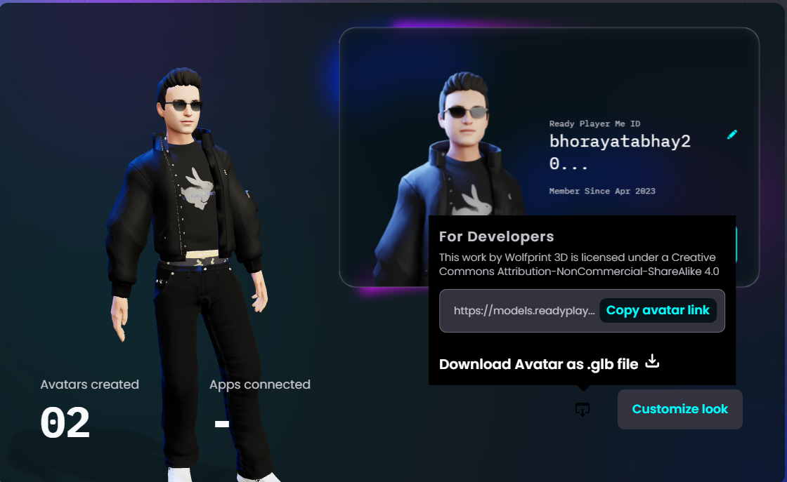
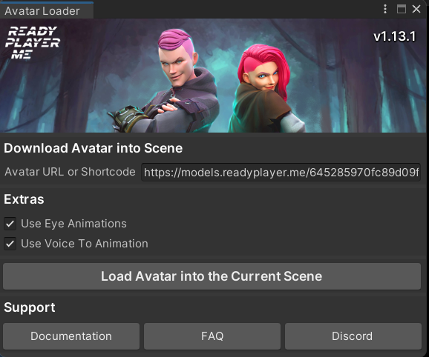
ready PLAYER ME

Slide 11
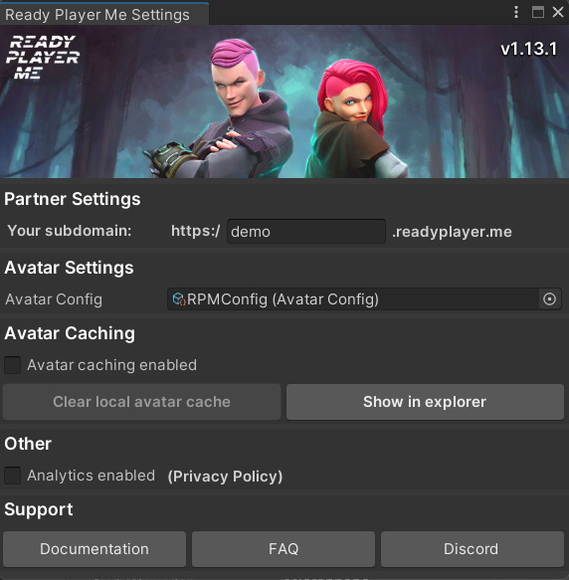
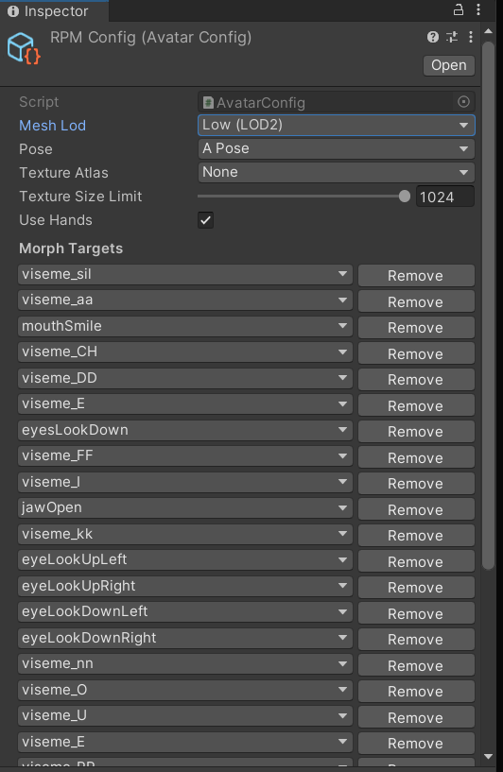

Slide 12
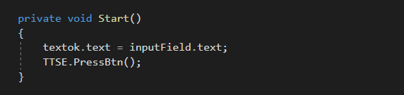
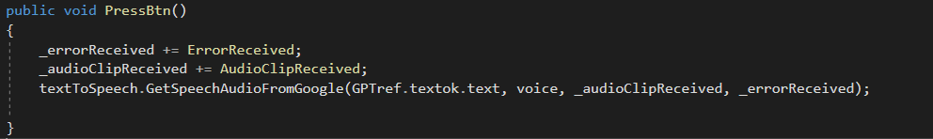
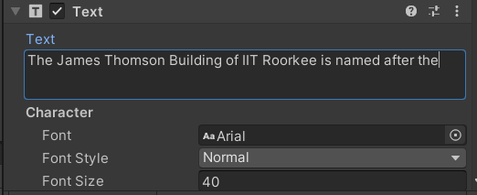
GOOGLE TEXT TO SPEECH

Slide 13
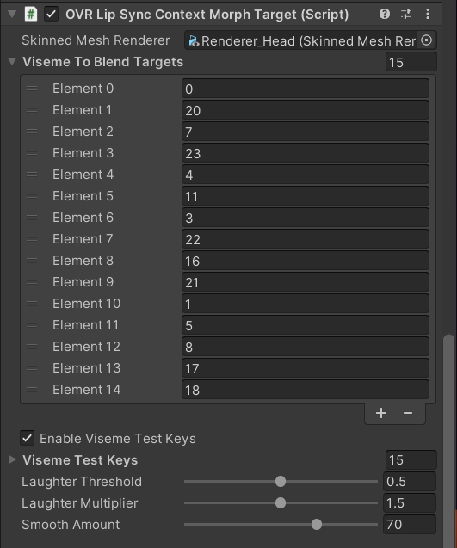
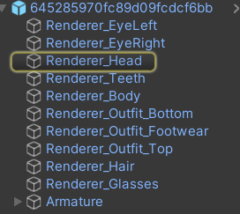
lipsync

Slide 14
CHallenges
One of the major challenges we faced was the Lipsync of the player as initially when we import the player using the Ready Player Me Loader, the number of blend shapes The player has and the blend shapes needed by the ovr lipsync are different so it was not working, then after researching more and looking at the example scene provided we added some more blend shapes to it and then it finally worked.

Slide 15
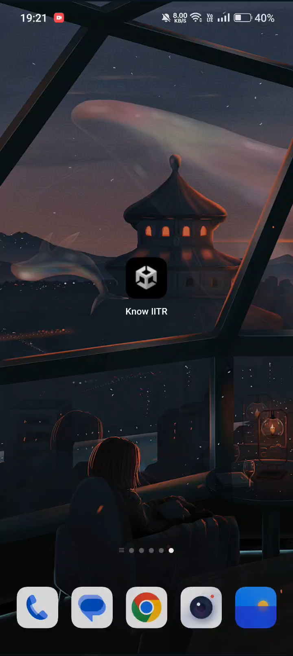
Working video

Slide 16
Future plans
As of now the app only provides the information about the James Thomason Building and the EED Building but in the coming future more and more buildings and characters can be added.
As right now we are using a random image for image detection but later the sign boards can be used and anyone can know about the buildings directly pointing his/her phone camera on the sign boards.
Also this can be made a fun app for Childrens and can be used to teach them about the 7 wonders of the world or famous monuments using this method and the app can be published on Play Store.

Slide 17
THANK YOU

